Slide 1
SOAPSTone homework
DIRECTIONS: Look at the 5 images on the next few slides. Select ONE, and complete the SOAPSTone sheet you were Given in class. Write in pen, and write legibly.

Slide 2
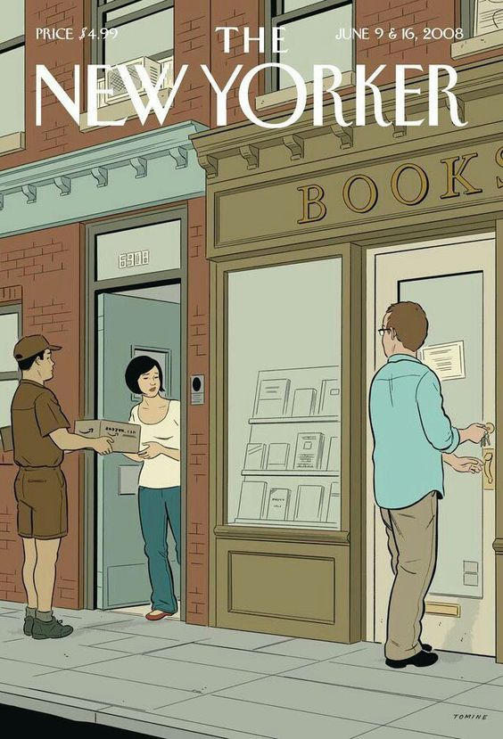
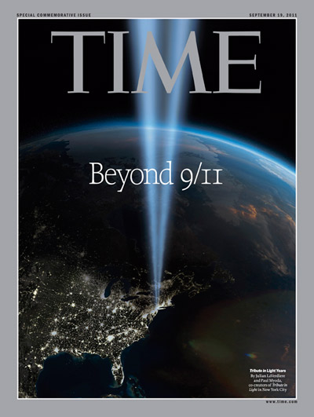
Options 1 and 2
OPTION 1:
The New Yorker
June 9 and 16, 2008
OPTION 2:
Time
September 19, 2011

Slide 3
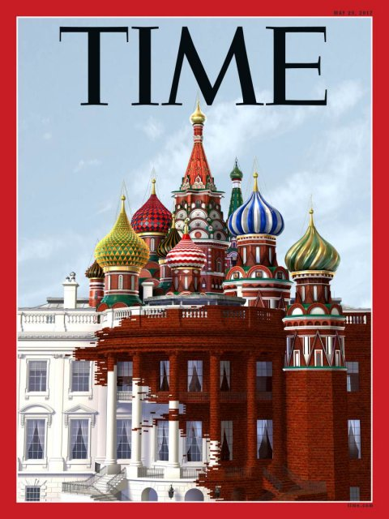
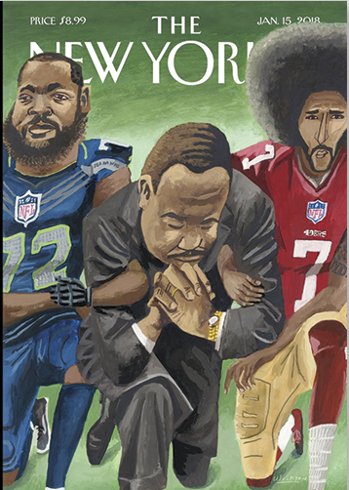
OPTIONS 3 and 4
OPTION 3:
Time
May 29, 2017
OPTION 4:
The New Yorker
January 18, 2018

Slide 4
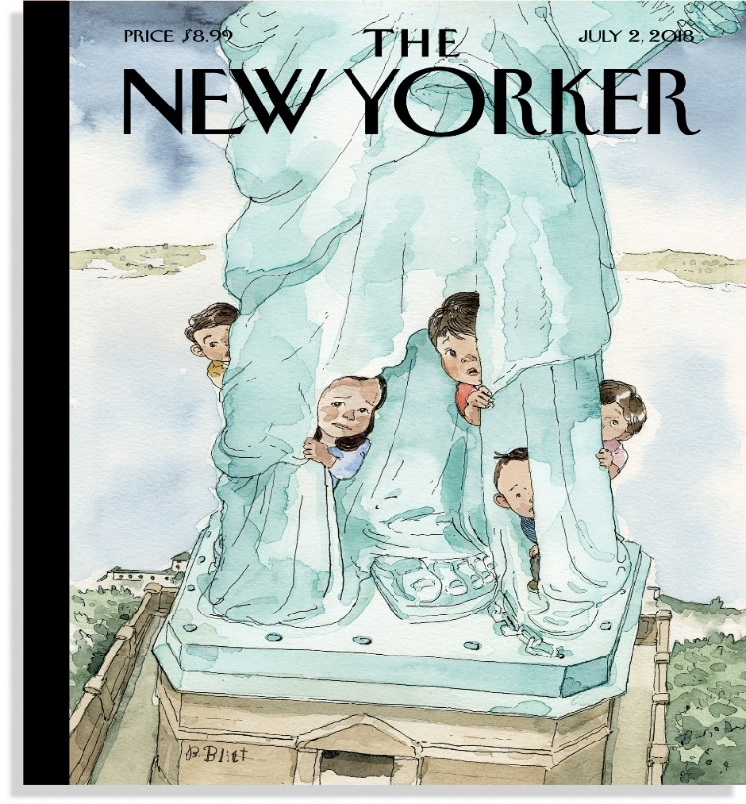
OPTION 5
OPTION 5:
The New Yorker
July 2, 2018

